Slide 1
Q4 outage $202M-$157 M= ($44M)
In this quarter, the original production from Surjek would reduce revenue in -22%
$44
Notes:
Chart: revenue after reduction

Slide 2
Decision: Q4 | Projected revenue-loss $157 M
Surjek
Kootha
Jutik
-44 million -22% is the estimated reduction in Surjek’s Revenues

Slide 3
As market demand ↑ prices ↑
Average Water Balancing Market Price Market Water Demand (Mega-litres)
Notes:
Market demand rises and at the same time, prices get higher

Slide 4
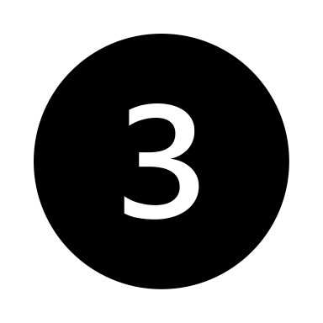
Kootha: most cost effective plant $25/ML
Overall Average WBMP (Water Balancing Market Price)
place
place
place
Overall Desalination Cost to Produce ($/ML)
Notes:
Of the three Desalination Plants, all three remain profitable at current market prices by a favourable margin; Clearly Kootha is the most cost-effective $25 /ML) followed by Jutik ($35.8/ML) and lastly Surjek ($54.23/ML) which is consistent across the July-2013 to June-2014 period.

Slide 5
Aggregate cost to produce
Overall Cost to produce Surjek Jutik Kootha
Sep 13 - Nov 13 just in this period Surjek increased 28% for unknown reasons in the case
Notes:
Aggregate Cost to Produce vs Kootha, Surjek and Jutik
Surjek hits a cost peak in November 2013 and then it lowers every month.

Slide 6
Cost to produce vs. Water volume produced
Concentrated costs & production | High cost and volume variation | Lower costs in general
Jutik Surjek Kootha

Slide 7
Average water quantity vs WMB Price*
Mid-range product | Price inelastic @ $93 & $110, top of line | Slightly more elastic
Soft + Hard water Hard water Soft water
Notes:
*WMB Price =Avg. Water Market Balancing Price
Drilling down further from a product-perspective, reveals two different patterns of elasticity where Hard water tends to be relatively price inelastic regardless of quantity purchased, whilst Soft water is more representative of an elastic price-to-volume relationship.

Slide 8
Water Balancing Price ($/ML)
Combo of elastic and inelastic | Fixed-priced marks | Slightly more elastic
Soft + Hard water Hard water Soft water
Notes:
For the consumer, Soft Water is seen as more of a ‘less core’ product than that of Hard Water whose price remains largely inflexible.

